Slide 1



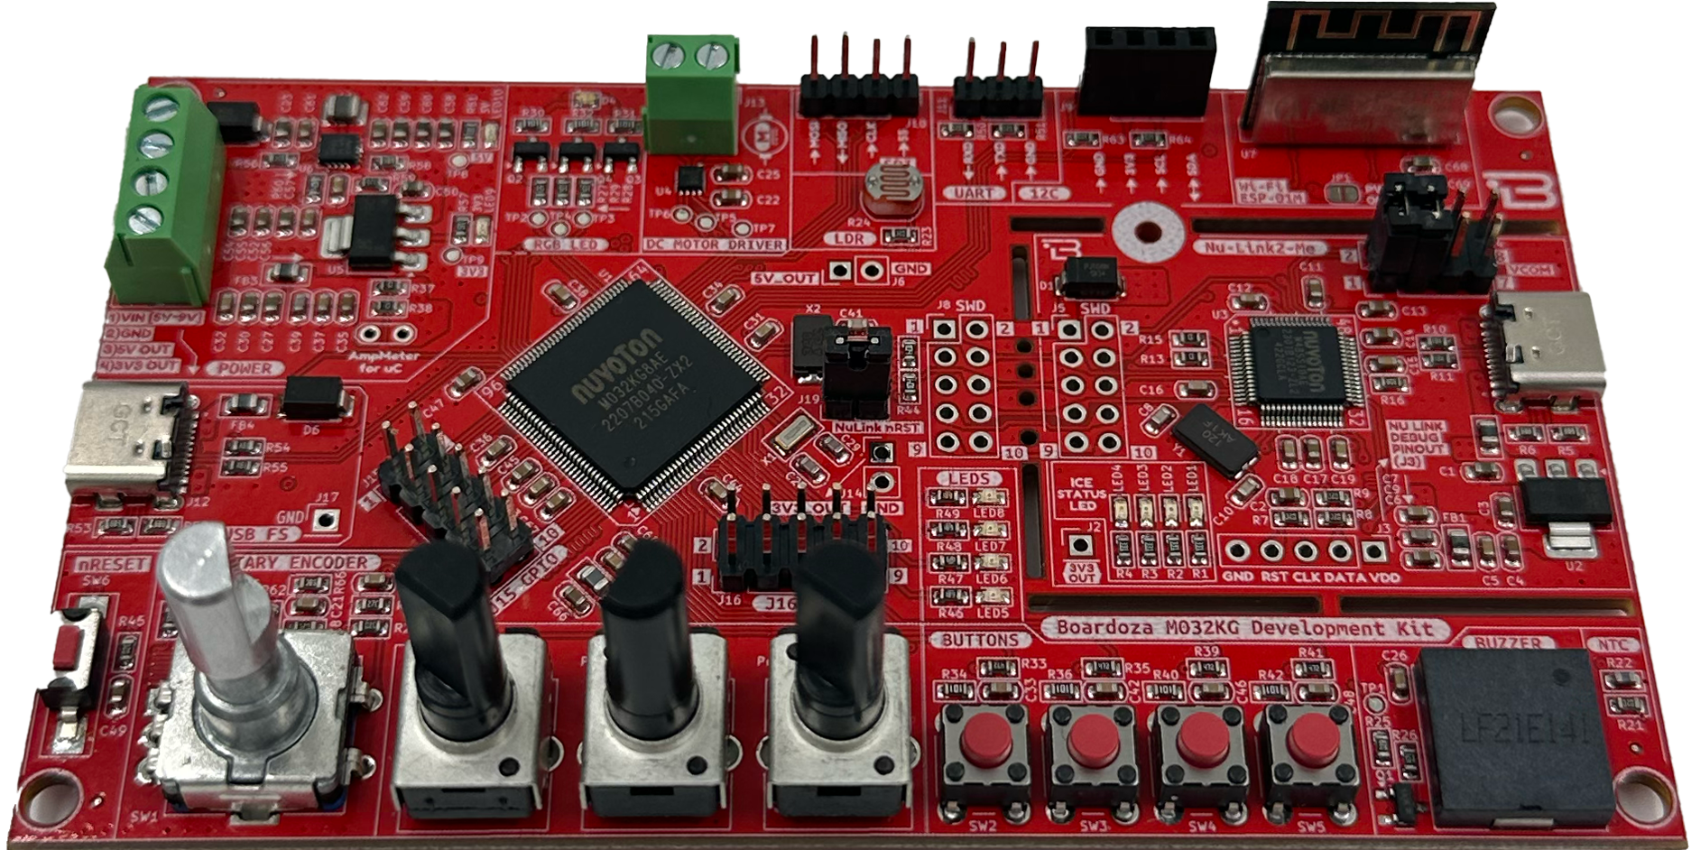
NUVOTON M032KG BOARDOZA GELİŞTİRME KARTI
M032KG GPIO İşlemleri
DERS 3 – BUTON İLE
LED SÜRME
BOARDOZA M032KG
Development Board
Doç. Dr. Barış GÖKÇE
Şubat 2025
https://github.com/brgokce/NUVOTON-M032KG

Slide 2
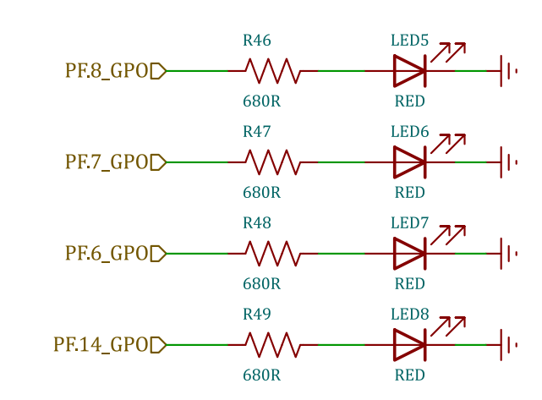
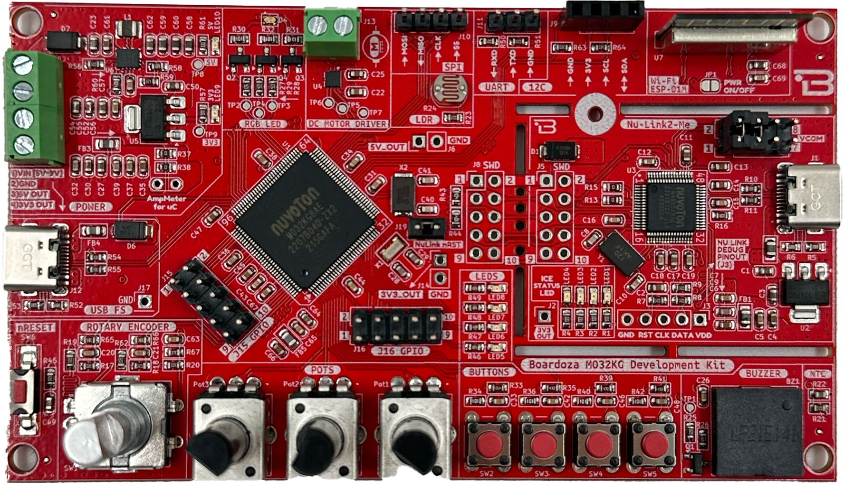
LEDS
https://github.com/brgokce/NUVOTON-M032KG

Slide 3
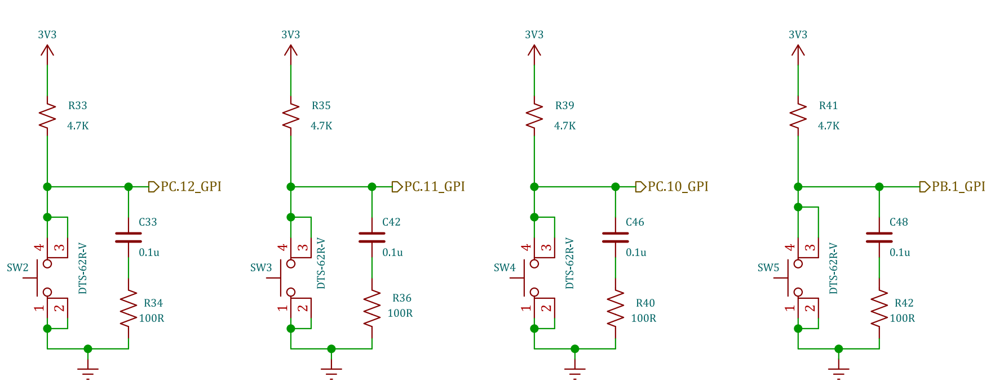
User Buttons
https://github.com/brgokce/NUVOTON-M032KG

Slide 4
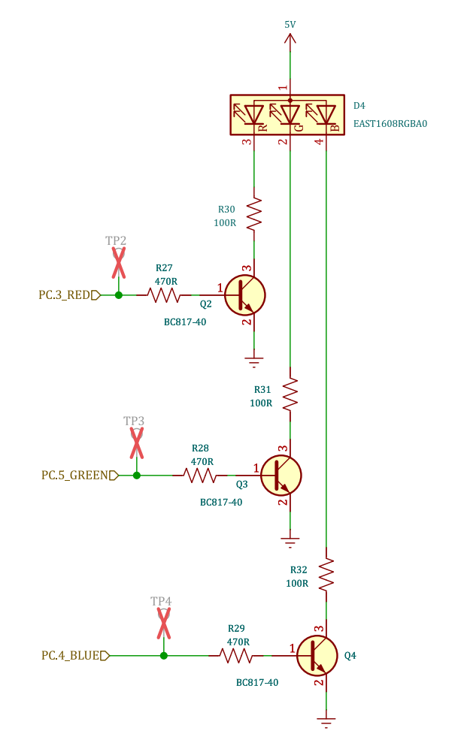
RGB LED
https://github.com/brgokce/NUVOTON-M032KG

Slide 5
Teşekkürler
Dr. Barış gökçe
https://github.com/brgokce/NUVOTON-M032KG

